Slide 1
Data wrangling & exploratory data analysis
GEOG4300 /6300: Intro to data science
Prof. Jerry Shannon

Slide 2
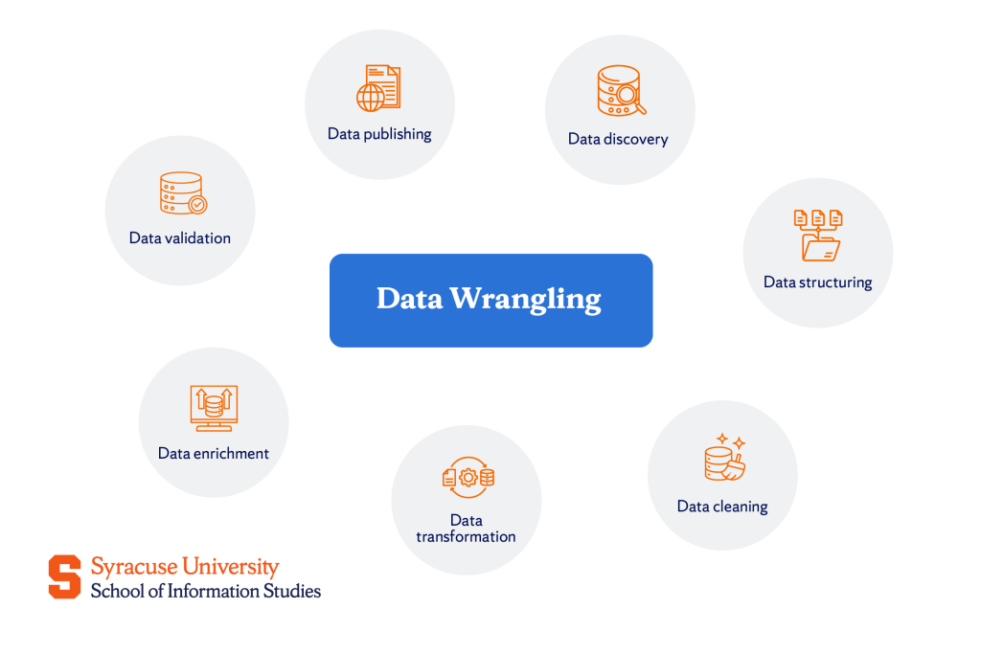
Data wrangling: steps
Data discovery
Data structuring
Data cleaning
Data transformation
Data enrichment
Data validation
Data publishing

Slide 3
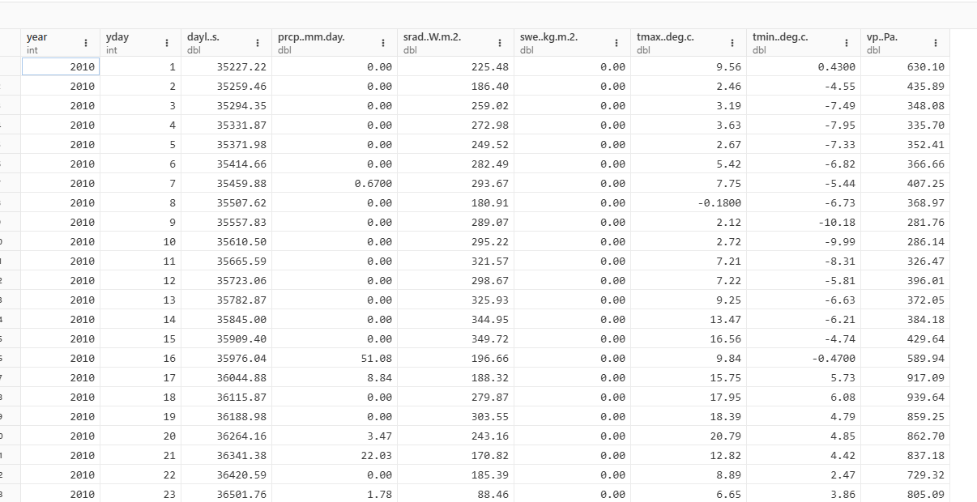
Let’s think about Daymet data
Data discovery
Data structuring
Data cleaning
Data transformation
Data enrichment
Data validation
Data publishing
What would the highlighted steps look like?

Slide 4
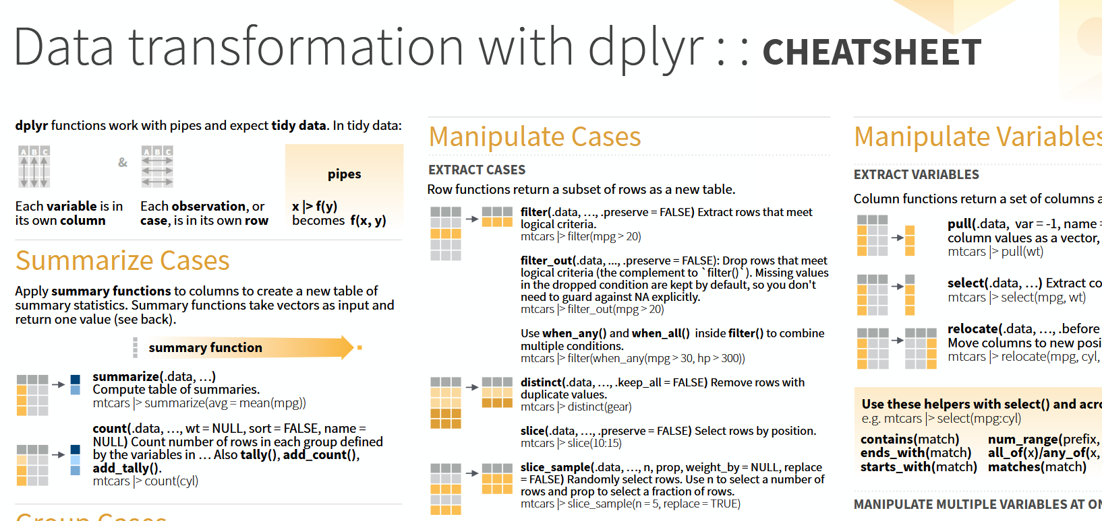
In the tidyverse: the dplyr package
The posit cheatsheet is linked on the Module 3 page.
Pick two functions:
What do they do?
Why would you use them?

Slide 5
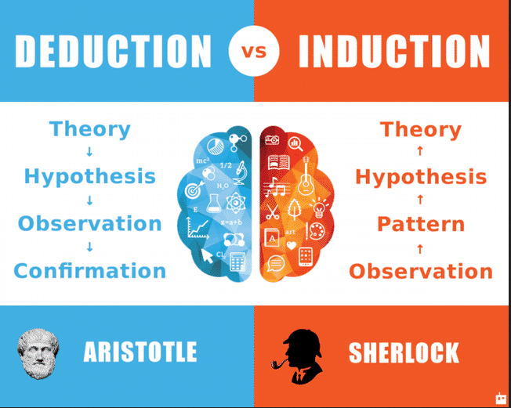
What is exploratory data analysis?

Slide 6
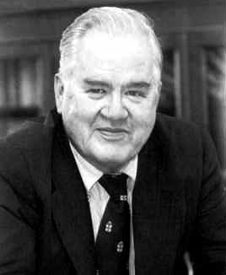
What is exploratory data analysis?
John Tukey
“Numerical quantities focus on expected values, graphical summaries on unexpected values.”

Slide 7
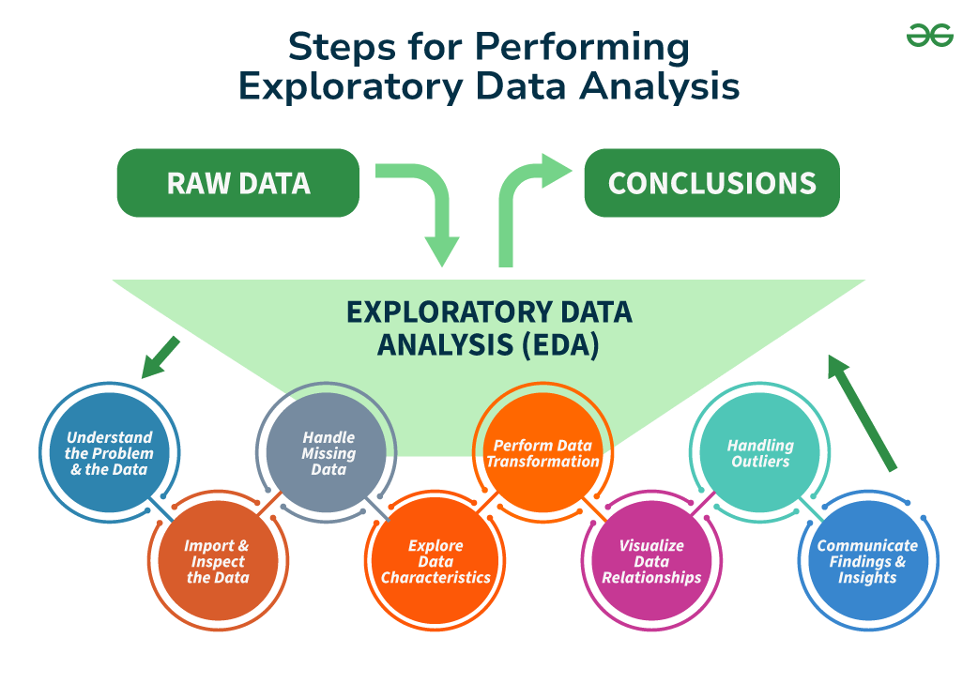
https://www.geeksforgeeks.org/what-is-exploratory-data-analysis/

Slide 8


Tukey and Wickham on Exploratory Data Analysis
Notes:
Depending your approach, classification methods can paint very different pictures of the same data points.
How might we interpret the natural breaks map differently from the quantiles map here?

